Slide 1

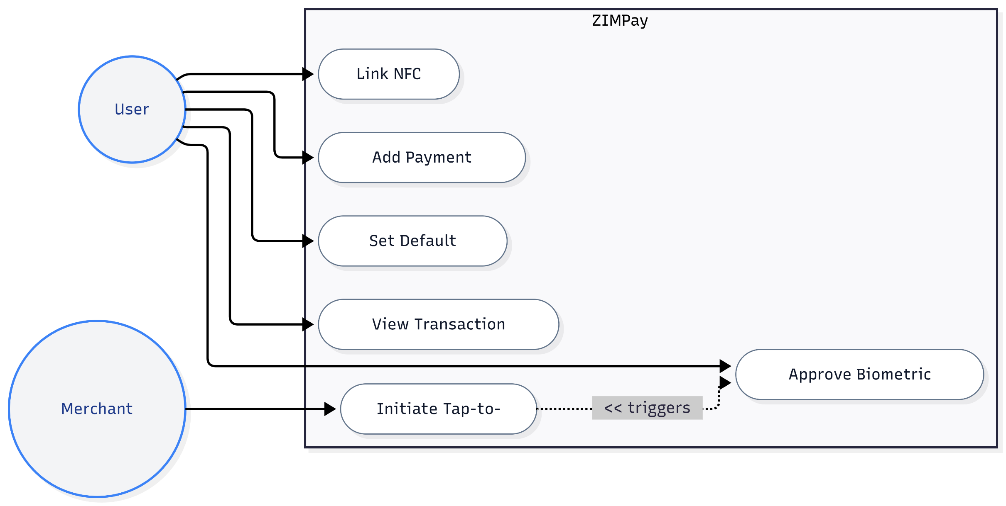
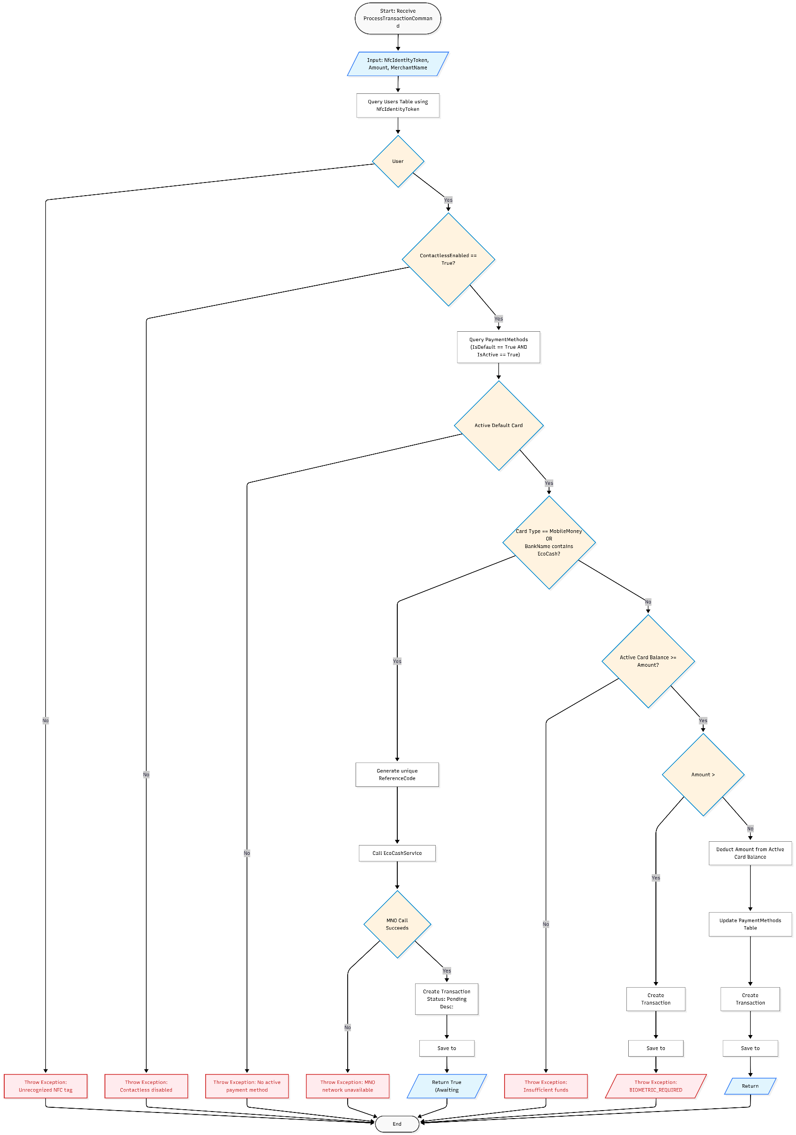
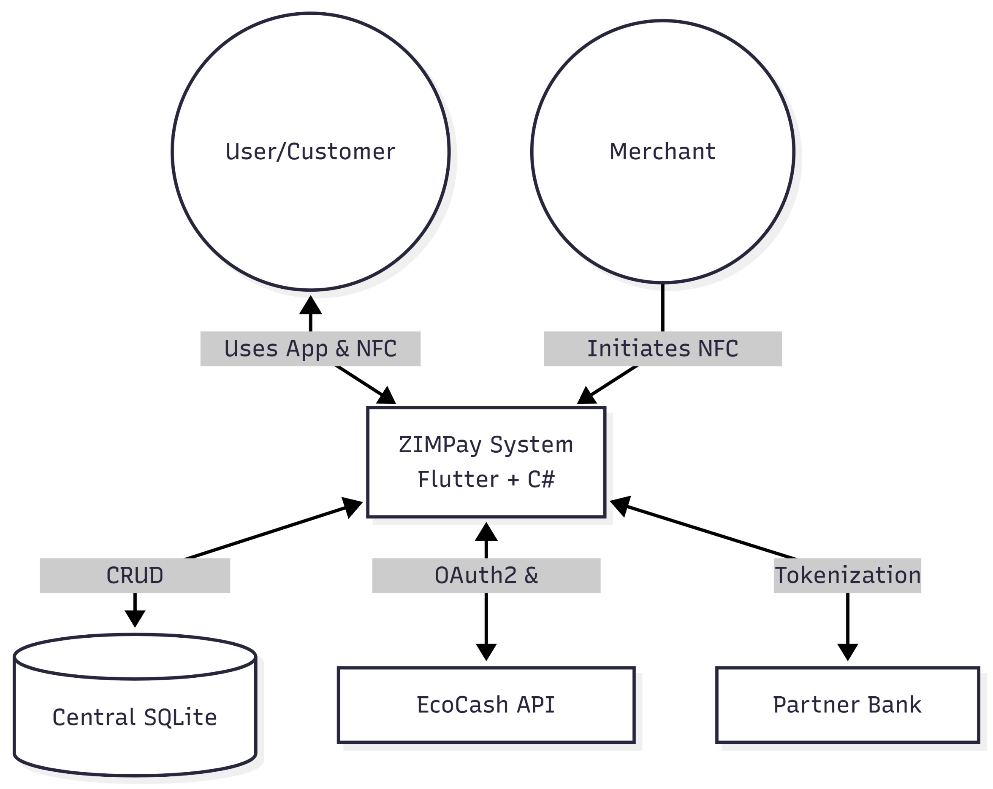
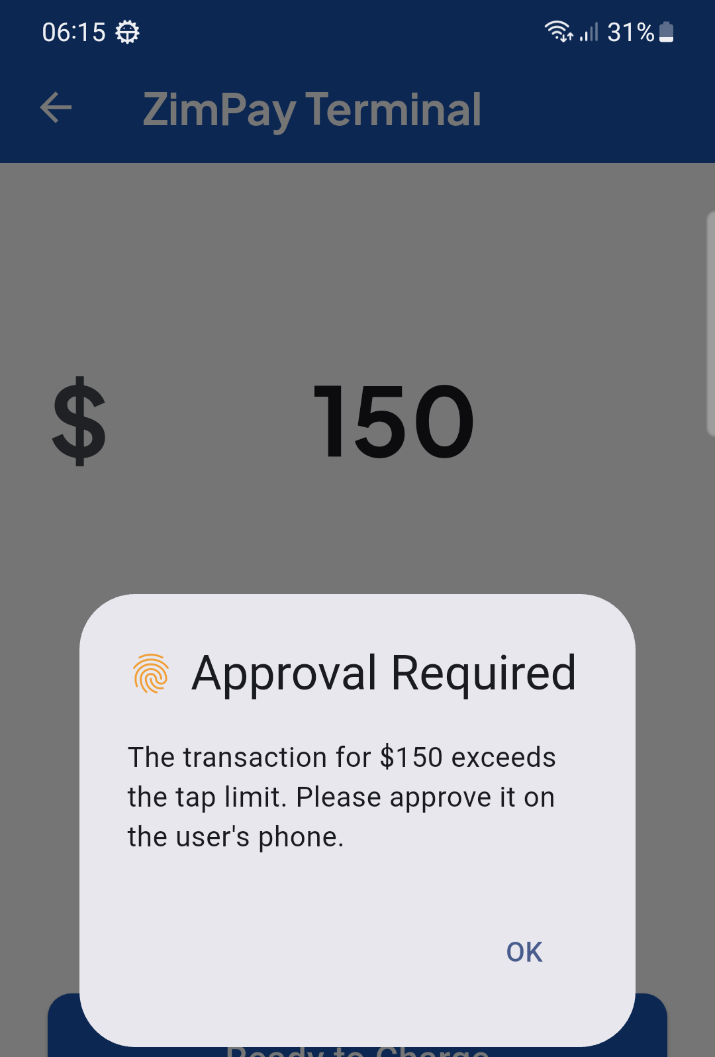
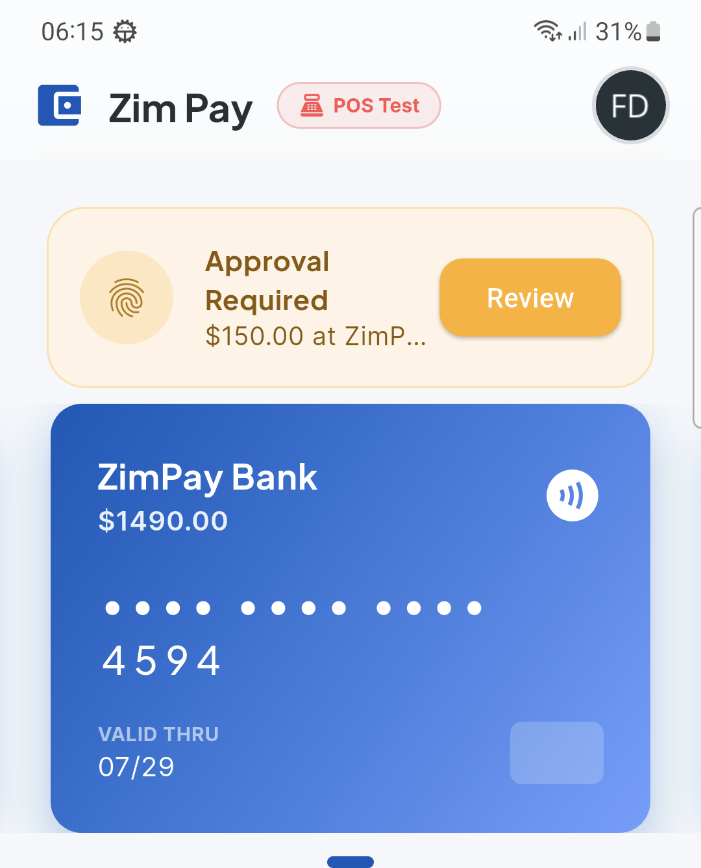
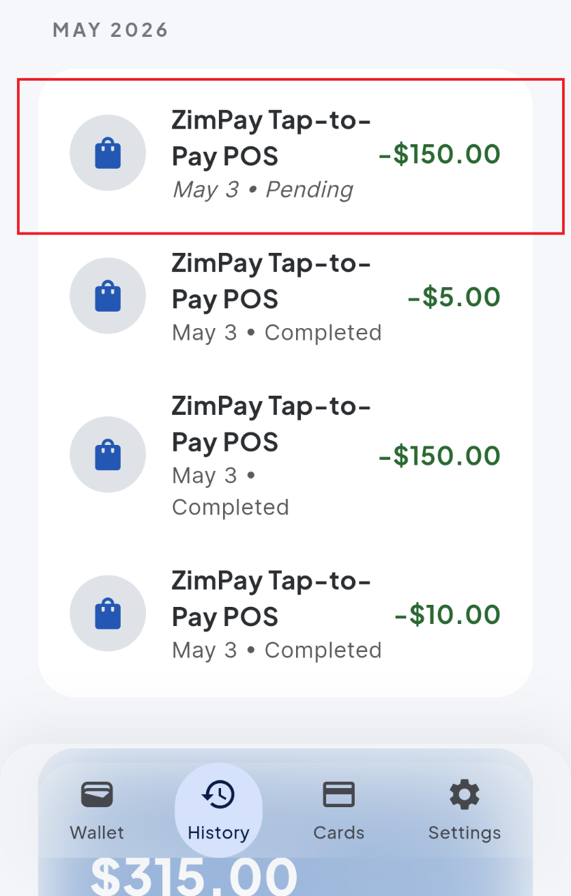
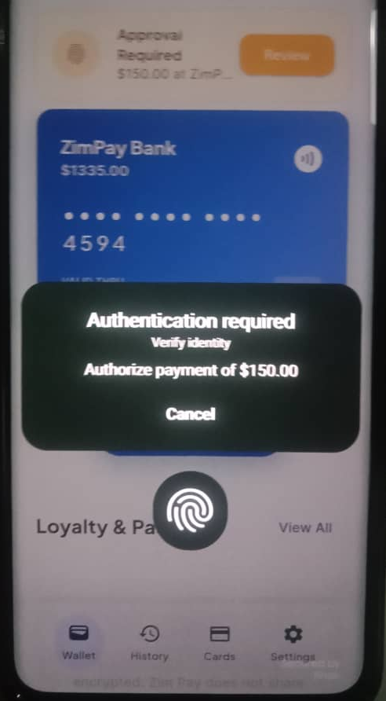
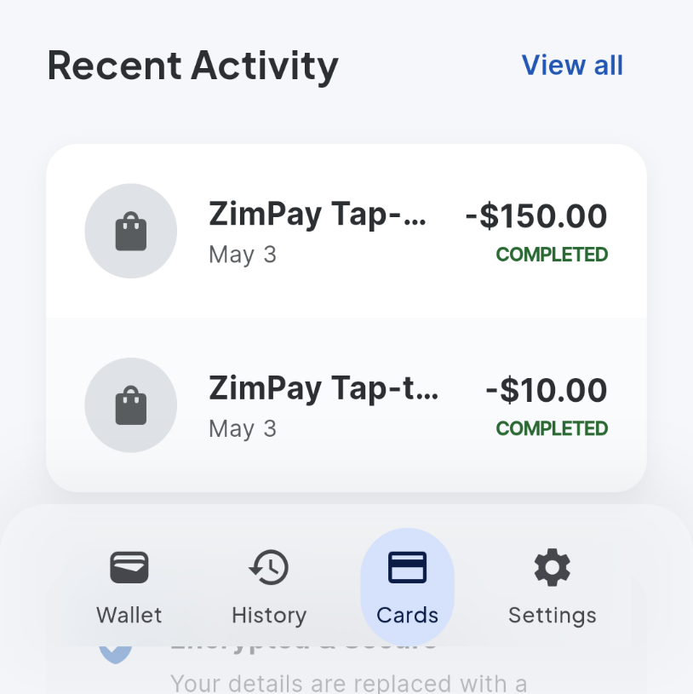
ZIMPay: Near Field Contactless Payment Platform
Department of Computer Science, School of information Sciences and Technology, Ganges Rd, Box BE 277,Belvedere,Harare,Zimbabwe
Student: VICTOR MOYO H220204H, Supervisor: Mr E. Mutevani
h220204h@hit.ac.zw,
emutevani@hit.ac.zw
Abstract
Use Cases
Conclusion
In developing economies, mostly in the third world countries, payments following a direct-to-customer transaction tend to cause unnecessary friction created by the slow drifting of the masses, from traditional bank ledgers to Mobile money. ZIMPay works smoothly and efficiently at the Point of Sale (POS), simply by unifying digital wallets that support earlier and modern forms of banking, utilizing affordable, compliant NTAG215 hardware;
Routing, financial tokenization, are run by a centralized C# .NET Digital Custodian.
A physical NFC tag is used only as an identity credential and does not reveal any information in plain text.
It is client-server based, equipped with a mobile biometric scanner, and has data encryption using AES-256. Formidable strides in system testing have been made, following the abolition of manual USSD entry at POS and intensified protection from cloning and/or theft. Still, hurdles remain ahead, like interoperability with legacy systems, achieving unwavering offline running, and difficulties in user adaptation across markets with varying levels of digital literacy according to (Reddy & Banda, 2024). To achieve greater adoption and success of digital custodian systems, these challenges need to be addressed, especially in countries creating digital payment networks.
.
ZIMPay proves that an NFC system, which is encrypted, tokenized, and has a consensus of local biometrics, can serve Zimbabwean citizens as an excellent means of securing fast and convenient financial transactions.
Future work
Offline transactions: Future iterations must investigate Dual-Offline Payment schemes that leverage ZKPs and TEEs. This will enable Biometric Gatekeeper to authorize micro-transactions in an offline environment.
Multi-currencies and exchange engine: The backend application layer must be upgraded to offer dynamic support of several currencies (e.g., USD and ZiG). It will also incorporate the inclusion of a live exchange rate oracle to automate the settlement of cross-currency tap-to-pay transaction requests.
Integrating POS systems: Configuring the C# backend API to interact with pre-existing EMV-compliant contactless POS systems deployed in Zimbabwean supermarkets is important.
Introduction
System Overview
Zimbabwe's financial services are cash and digital payments based. There are other popular mobile applications for payments companies, such as Ecocash, and cash, including US dollars and Zimbabwean gold (Zig), still being widely used by many shoppers.
NFC is a short-range wireless technology that allows encrypted data to be transmitted and can help to tie various payment methods together (Coskun et al., 2015, p. 13348). To this end, this study offers a payment app and a digital wallet, named ZIMPay. The proposed app aims to unify multiple payment methods into one secure wallet, in order to enable the use of the tap-to-pay functionality with NFC.
Results and screenshots
References
Problem Statement
Makkena, B. (2024). Ultra-Low Latency Architectures for Secure Real-Time Payment Processing: Achieving Sub-50ms End-to-End Throughput. https://doi.org/10.3390/electronics11020173
Niyongabire, P. (2024). Biometric banking system for effective paperless cash withdrawals at CRDB Bank Burundi. https://doi.org/10.58694/20.500.12479/2930https://doi.org/10.4102/sajim.v22i1.1194
Albu, S. (April 29, 2026). ICICI Bank adds biometric authentication to UPI payments on iMobile. The Paypers. https://thepaypers.com/fraud-and-fincrime/news/icici-bank-adds-biometric-authentication-to-upi-payments-on-imobile
(November 12, 2024). dLocal and Zepz partner to provide improved cross-border payments across Africa, Asia, and Latin America. dLocal. https://www.dlocal.com/press-releases/dlocal-and-zepz-partner-to-provide-improved-cross-border-payments-across-africa-asia-and-latin-america/
Team, B. (2025). Mobile Money &amp; Telecom Partnership Strategy. BinaxPay. https://hub.binaxpay.com/partnership/mobile-money-telecom-partnership-strategy/
It has been noted that the current digital payments environment in Zimbabwe is fragmented, insecure, and lacks efficiency in conducting retail transactions. (Digital Transformation a Key Enabler of Long-Term Resilient Growth in Zimbabwe, 2021) What is needed is the creation of an integrated system that will combine different modes of mobile money and banking payments into one secure and efficient system. This proposed system will make use of NFC technology combined with native biometrics security to help streamline transactions as well as minimize costs and waiting time. (Alimi et al., 2013, pp. 1-17)
ZIMPay is a secure “Digital custodian” that unifies fragmented bank and mobile money accounts to execute contactless POS transactions via low-cost, zero-plaintext passive NFC tags.
Its decoupled C# .NET 10 backend dynamically routes charges while enforcing end-to-end system integrity through AES-256 tokenization and a mobile Biometric Gatekeeper.
Use Cases/Flowchart/etc (UML)
If fingerprint authentication is verified the transaction is marked as “completed,” and card is deducted.
The Digital Custodian Routing Algorithm is at the core of the ZIMPay ecosystem that automatically sends a process forward linearly when the API detects a ProcessTransactionCommand. The user is identified using his NfcIdentityToken and then the user queries the PaymentMethods, and it finds IsDefault == true and the Type is checked.
In case the Type is a bank card, the algorithm checks the balance and tap limit and either deducts the amount or places it on hold pending authentication by a biometric method.
In case the Type is "MobileMoney", the process of deduction is put on hold, a unique referenceCode is generated and the API sends a REST call to the foreign Mobile Money provider network such as EcoCash, thereby placing it in the state of "Pending".
Objectives
To design and execute a simulated NFC-based tap-to-pay transaction protocol.
To implement a secure user authentication mechanism.
To formulate and evaluate a centralized financial aggregation model.

